Slide 1

ABDU RAHMAN P S Final Project

Slide 2

PROJECT TITLE
Titanic - Machine Learning from Disaster

Slide 3

AGENDA
Introduction to Titanic Shipwreck Dataset
Data Exploration
Investigating the structure and contents of the dataset to gain insights.
Understanding the background and significance of the dataset.
Feature Engineering
Creating new features and transforming existing ones for model development.

Slide 4
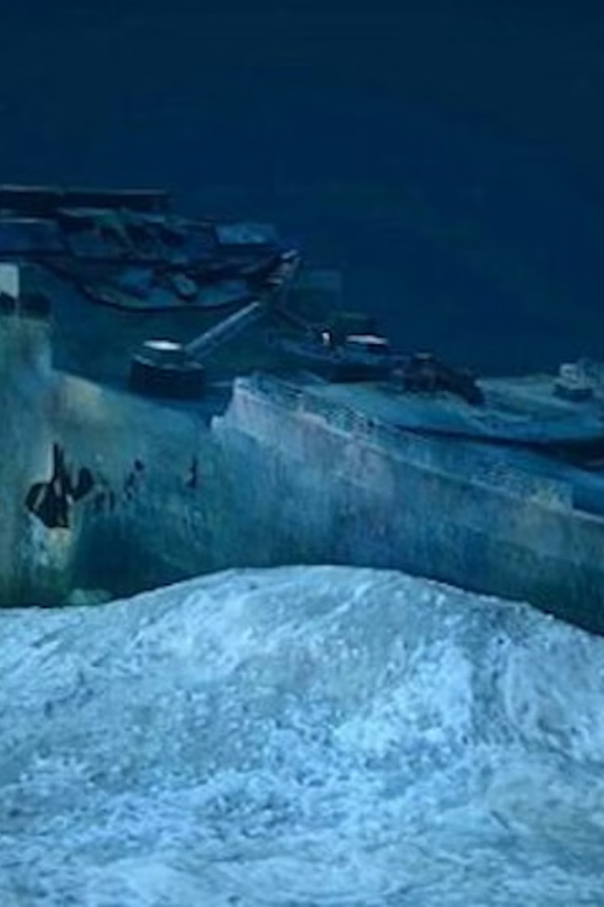
Problem Statement
The challenge is to create a machine learning model that predicts the survival of passengers during the Titanic shipwreck based on various factors.

Slide 5
PROBLEM STATEMENT
Identifying Survivors: Predicting which passengers survived the Titanic shipwreck.
Data Analysis: Analyzing the correlation between survival and demographic factors.
Impact Assessment: Understanding the implications of accurate survival prediction for historical analysis.

Slide 6
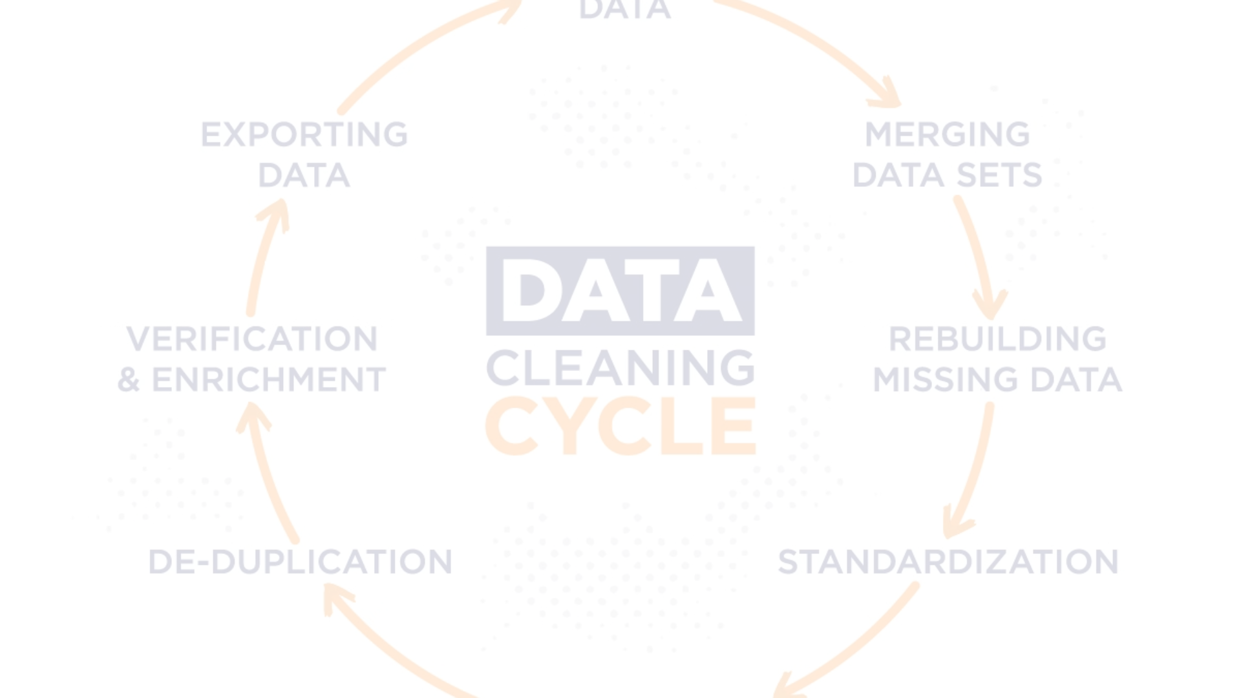
Data Preprocessing and Cleaning
1
Data Collection
Retrieve raw data from various sources, such as databases and files.
2
Data Cleaning
Remove duplicates, handle missing values, and correct any inconsistencies.
3
Data Transformation
Normalize, scale, and format data for machine learning algorithms.

Slide 7
YOUR SOLUTION AND ITS VALUE PROPOSITION
Accurate Predictions
Improved Safety Measures
Informed Decision-Making
Our machine learning model accurately predicts the likelihood of survival for Titanic passengers based on various factors such as age, class, and gender.
By understanding the survival patterns, our solution contributes to enhancing safety measures for future maritime journeys and emergency protocols.
Our model equips decision-makers with valuable insights to optimize passenger safety and survival strategies in the event of a shipwreck.

Slide 8
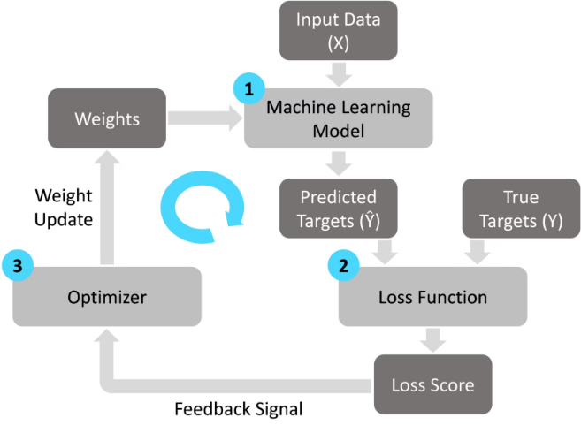
Training the machine learning model
After data preprocessing, the model is trained using a machine learning algorithm.
Various techniques, such as regression or decision trees, may be applied.

Slide 9
Model Performance Metrics
After training the machine learning model, it's essential to evaluate its performance using various metrics such as accuracy, precision, recall, and F1 score. These metrics provide insights into how well the model is performing and its ability to make accurate predictions.
Understanding the model's performance helps in identifying areas for improvement and ensures that the predictions are reliable and effective in real-world scenarios.
95%

Slide 10
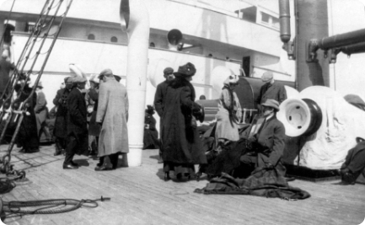
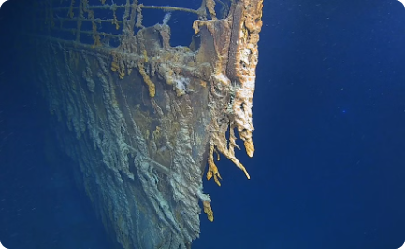
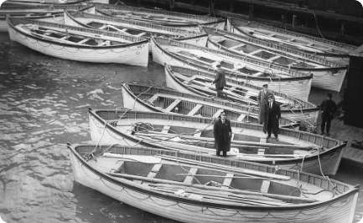
RESULTS
Survivors Rescued
Titanic Wreckage
Lifeboat Escape
A historic photo showing survivors being rescued after the Titanic shipwreck.
An eerie yet captivating image of the remains of the Titanic at the bottom of the ocean.
A dramatic portrayal of passengers escaping in lifeboats during the Titanic disaster.

